Slide 1

Presented by : Group 7
Members :
Akshita Garg Pranjal Grover
Rajas Thakur Shivani Tawde
Simran Gupta Sneha Bhagwat

Slide 2
PROJECT OBJECTIVE
Accidents caused by large trucks remain one of the leading causes of injuries and deaths in the United States.
Objective : To identify dangerous commercial truck drivers in California.
To answer common business questions related to the trucking business, such as: Which truck has the highest risk factor based on geographic location and time?
To meet the organizational goal of better understanding risk by analyzing trucking movement.

Slide 3
PROJECT WORKFLOW

Slide 4
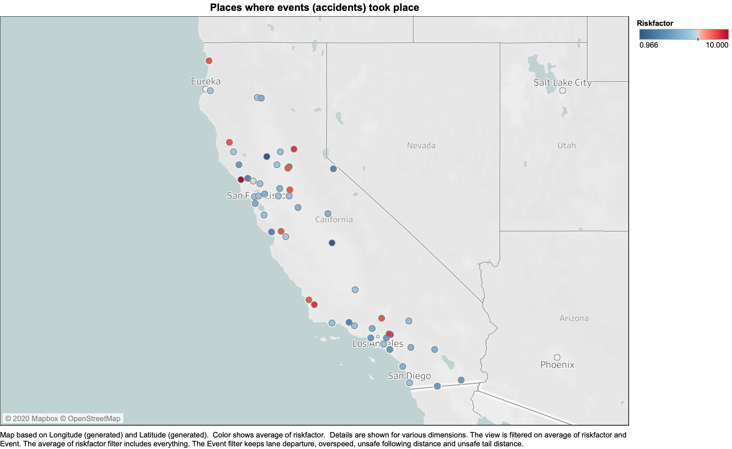
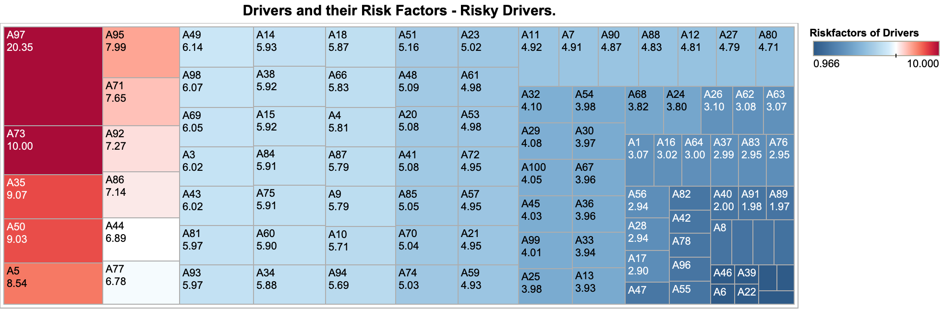
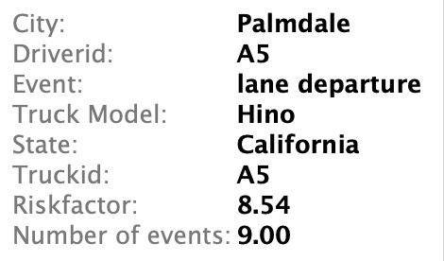

Slide 5
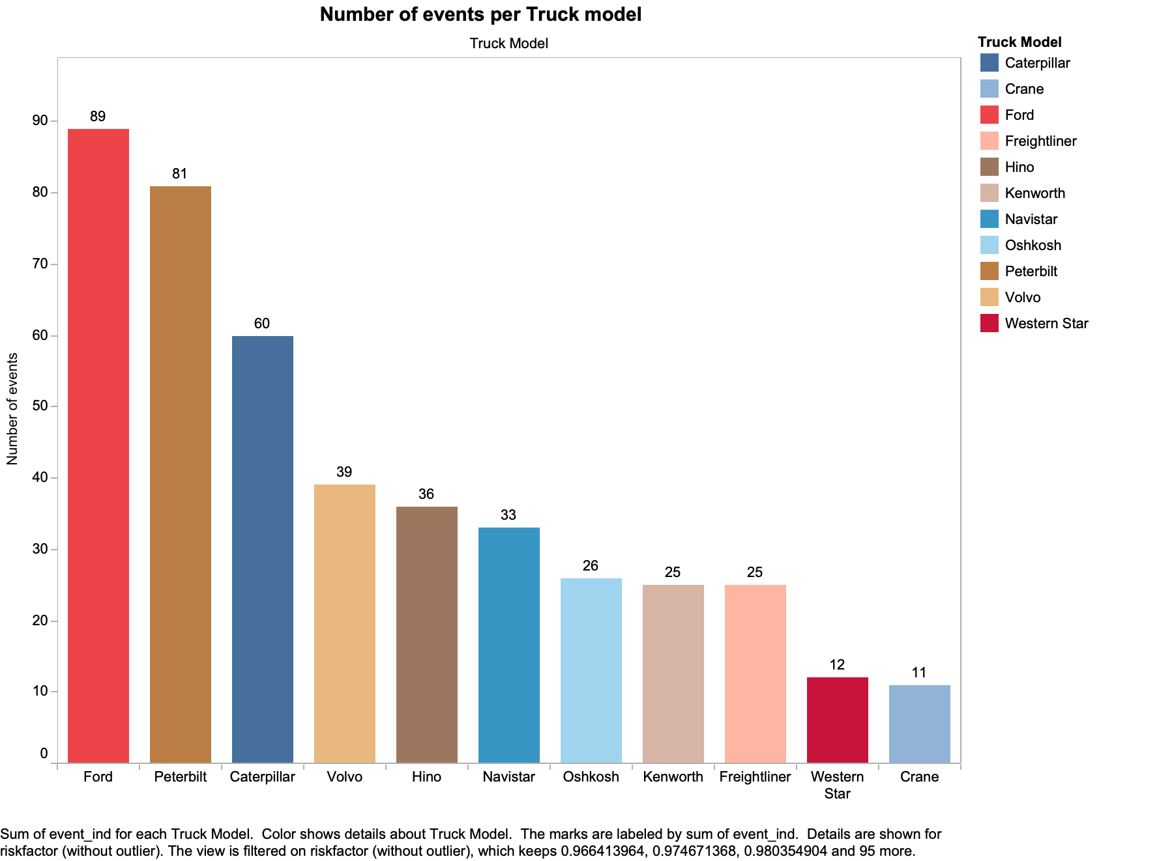
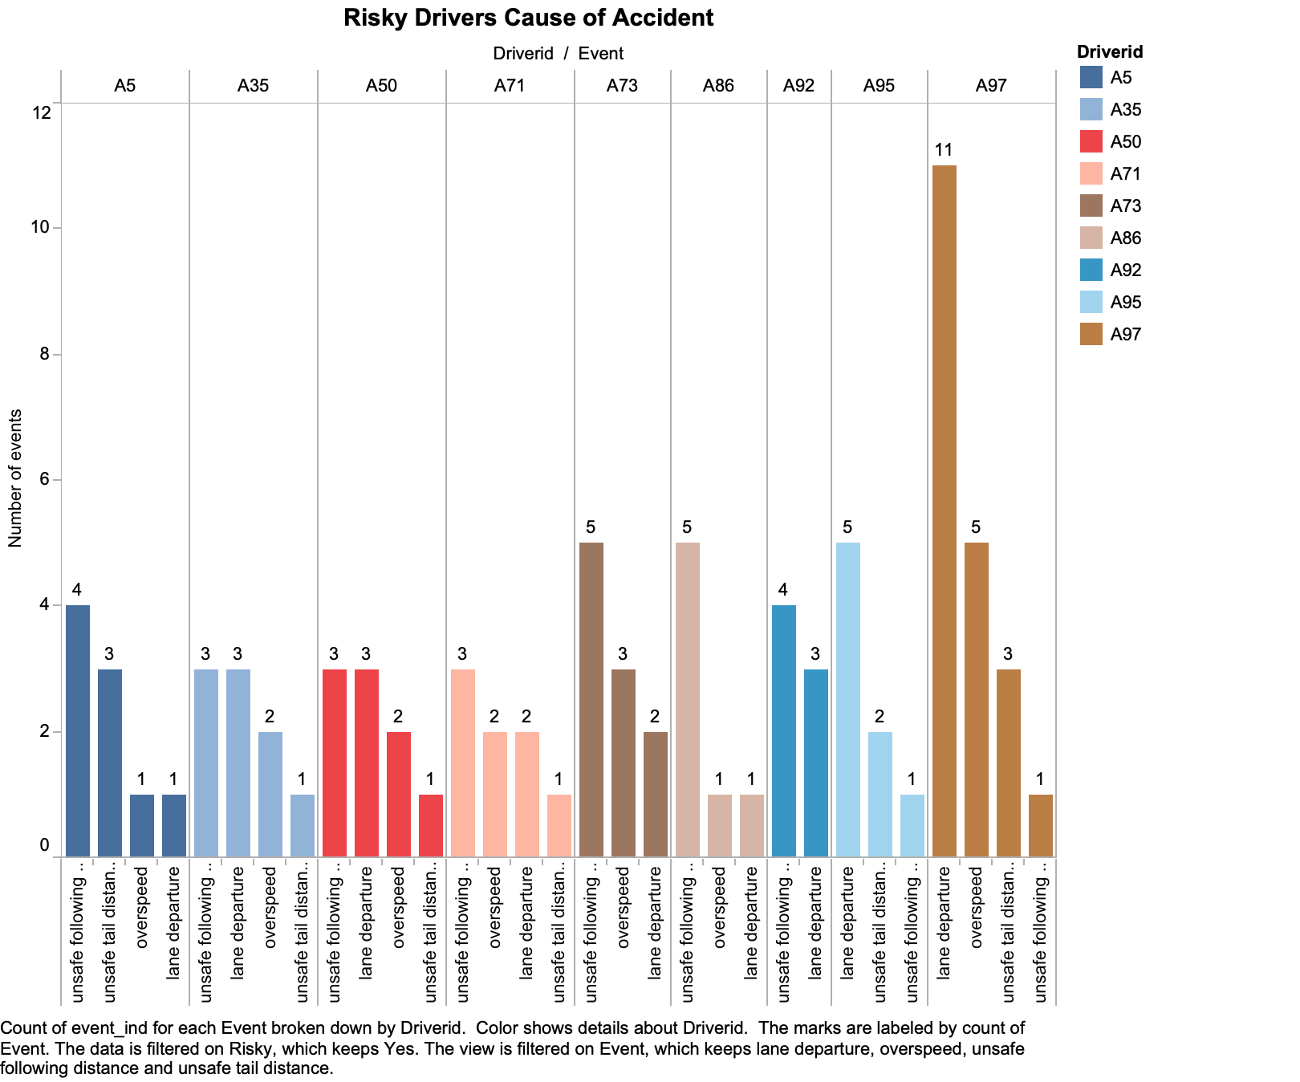

Slide 6
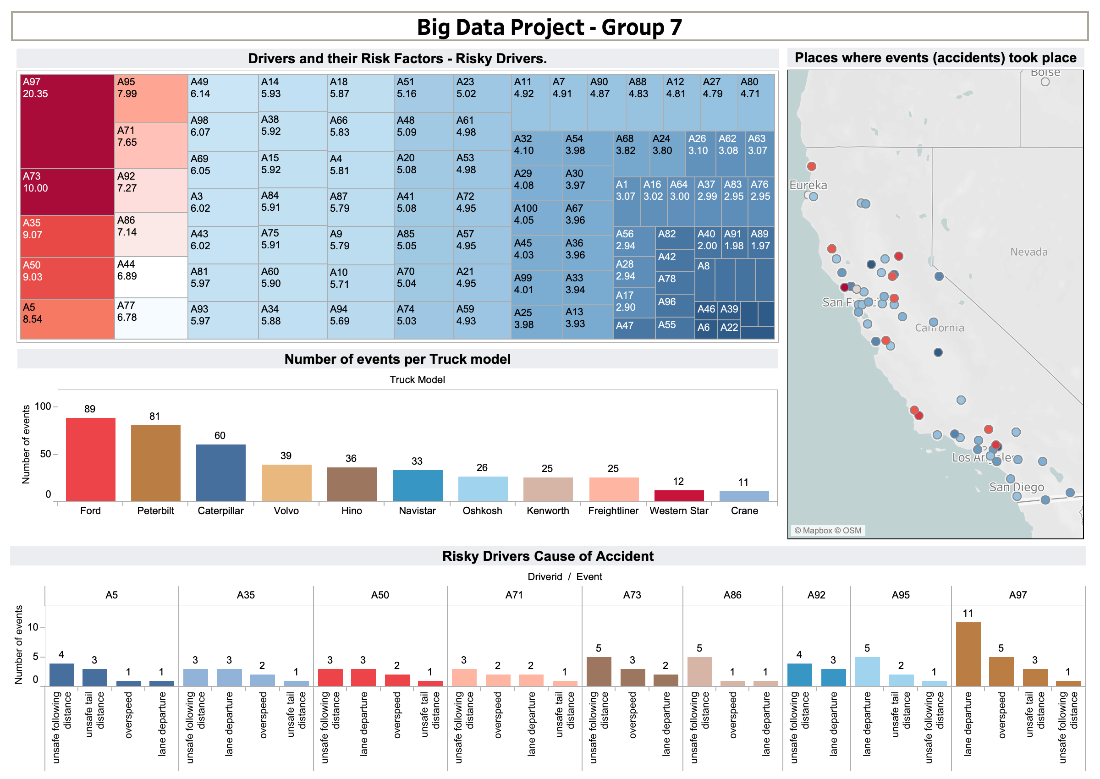
P
RO
J
E
C
T
D
A
S
H
B
O
A
R
D

Slide 7
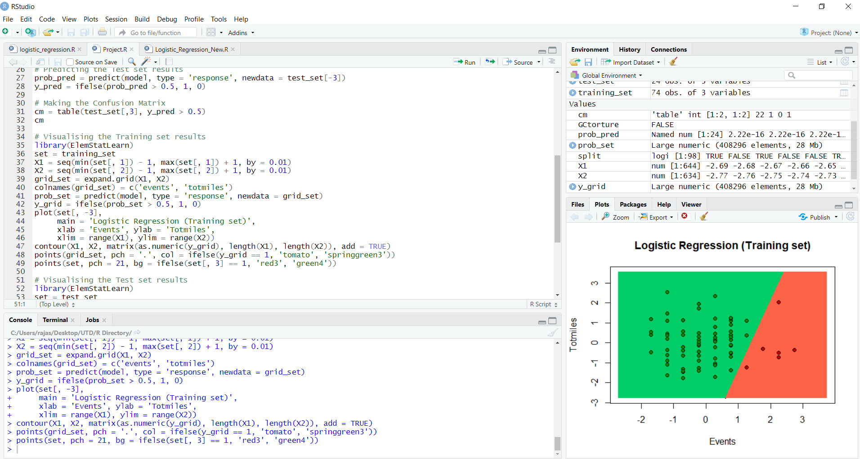
LOGISTIC REGRESSION

